Slide 1
Corporate Open Sourcing
Prof. Dr. Dirk Riehle
Friedrich-Alexander University Erlangen-Nürnberg
FOSS B08
Licensed under CC BY 4.0 International
Notes:
It is Friedrich-Alexander University Erlangen-Nürnberg – FAU, in short.
Corporate identity wants us to say “Friedrich-Alexander University”.

Slide 2
Three Stages of Open Source Engagement
Use
Contribute
Create and lead

Slide 3
The Primary Intent of Creating and Leading
Corporate
Open Sourcing
Developer
Foundation
open
Development Approach
N/A
Single-vendor
Open Source
closed
Not for profit
Commercial
Primary Intent

Slide 4
Benefits of Not-for-profit Intent
Corporate open sourcing
  Product
    Mature software faster cheaper → Improve product
    Harvest outside innovation → Improve product
  Recruiting
    Improve company reputation → Recruit developers more easily
    Collaborate with developers → Recruit better developers
  Employees
    Broaden employee perspective → Make employees more effective
    Make work more meaningful → Improve employee loyalty

Slide 5
Benefits of Commercial Intent
Developer foundations
  Take money out of a layer in the solution stack → Increase share of wallet
  → Sell to more price-sensitive customers
  → Grow addressable market
Consulting firms
  Build ecosystem (that you can't build alone) → Grow addressable market
Single-vendor open source
  Go-to-market → Market and sell more easily
See later lectures on business models

Slide 6
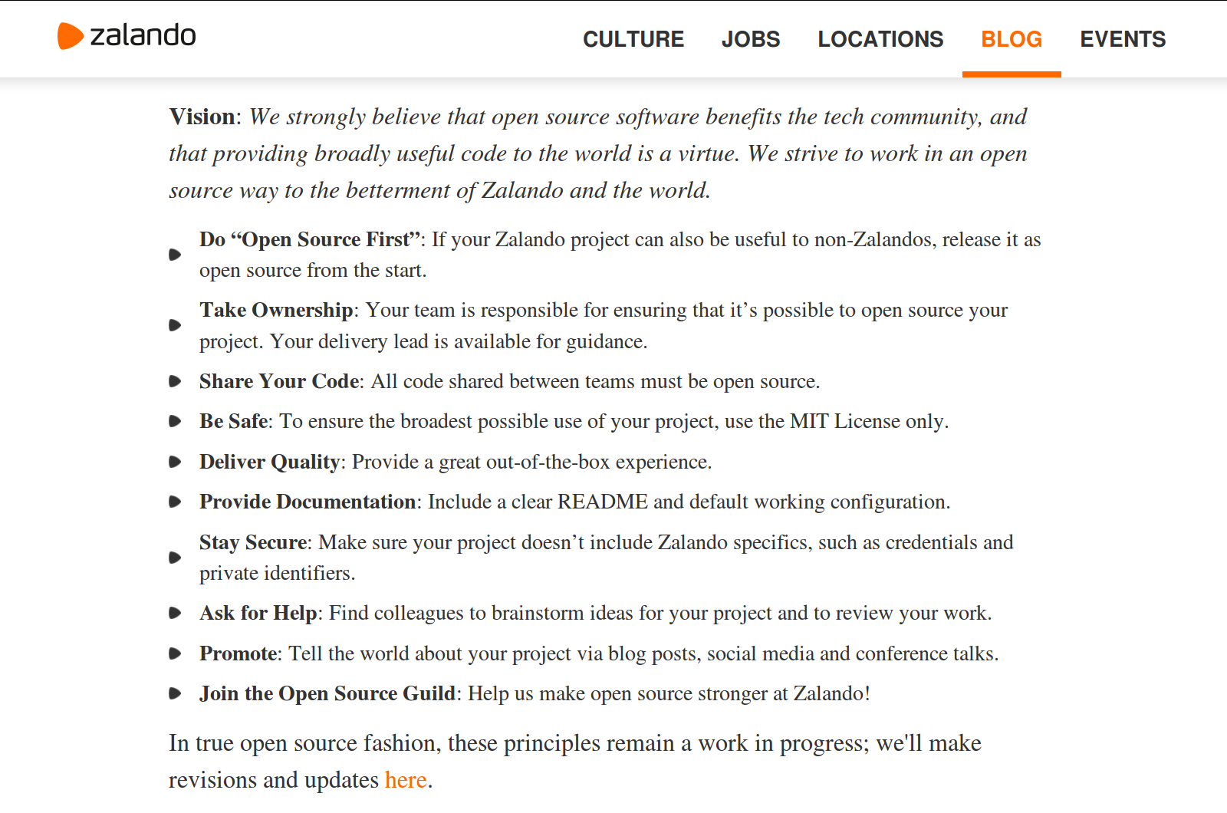

Slide 7
1. Mature Software Faster Cheaper
Mature software faster cheaper → Improve product
  Better product quality
    Widely used open source components mature faster
  Faster product development
    With many hands helping, components evolve faster
  Cheaper product development
    With many hands helping, one’s own costs go down

Slide 8
2. Harness Outside Innovation
Harness outside innovation → Improve product
  Better, faster and cheaper innovation
    More and more diverse parties speed up innovation

Slide 9
3. Improve Company Reputation
Improve company reputation → Recruit developers more easily
  Company demonstrates to developer public that …
    It is a thought leader
    It is doing interesting work
    Can engage with a community
  Makes a company more attractive as an employer

Slide 10
4. Collaborate with Developers
Collaborate with developers → Recruit better developers
  By collaborating with outside developers in project, the company …
    More easily finds developers interested in its technologies
    Can observe outside developers for their competence
    Has an effective way of reaching out (using developer peers)
  Makes recruitment easier and more safe

Slide 11
5. Foster Personal Development [1]
Foster personal development → Make employees more effective
  By collaborating with the outside world, employees ...
    Learn about new practices and technologies faster
    Improve their skills and competencies
    Gain a broader perspective
  Makes employees more effective
Also see lecture on inner source
[1] Employees are mostly developers, but sometimes others as well e.g. product managers

Slide 12
6. Make Work More Meaningful
Make work more meaningful → Increase employee loyalty
  By collaborating with the outside world, employees ...
    Receive additional recognition and validation of work
    Feel they perform more meaningful work
  Increases employee loyalty

Slide 13
Quiz on Corporate Open Sourcing 1 / 2
Guava [1] is a successful Java (utilities) library. Why did Google open source this library and what were the benefits?
  Improve product quality
  Recruit developers more easily
  Recruit better developers
  Make employees more effective
  Improve employee loyalty
[1] See https://github.com/google/guava

Slide 14
Quiz on Corporate Open Sourcing 2 / 2
React [1] is a successful Javascript framework for one-page web applications. Why did Facebook open source this library and what were the benefits?
  Improve product quality
  Recruit developers more easily
  Recruit better developers
  Make employees more effective
  Improve employee loyalty
[1] See https://github.com/facebook/react

Slide 15
Best Practices of Corporate Open Sourcing
All the best practices of
  Project communities
  Engineering processes
  Software tools use
New best practices for
  Internal communication
  Governance processes
  Public appearance

Slide 16
Role and Responsibility of Program Office
Open source program office
  Should manage corporate open sourcing
Program office responsibilities include
  Internal communication
  Governance processes
  Public appearance

Slide 17
Internal Communication (Practices)
The principle of “open source first”
  Leads developers to
    Reflect on business value of software component
    Having to find reasons for not open sourcing
  Sharpens business focus
    Due to clear understanding of what is competitively differentiating
    Also helps avoid not-invented-here syndrome

Slide 18
Governance Processes (Practices)
Clearance process
  Needs internal checklist for developers
    Will it create value (the intended effects)?
    Does it expose the company to risks?
IP management
  Needs to inspire trust in using component
    Requires clear intellectual property rights rules
Most will use a permissive license

Slide 19
Public Appearance (Practices)
Single primary project location
  A place for quality projects under company’s name
  A single place in a public location e.g. on Github
Project incubator
  A place for incubating a company’s open source projects
  Protects company reputation (from poor projects)

Slide 20
Review / Summary of Session
Benefits of corporate open sourcing
  Better product
  Easier recruiting
  Better employees
Best practices of corporate open sourcing
  Internal communication
  Governance processes
  Public appearance

Slide 21
Thank you! Questions?
dirk.riehle@fau.de – http://osr.cs.fau.de
dirk@riehle.org – http://dirkriehle.com – @dirkriehle
DR

Slide 22
Credits and License
Original version
  © 2012-2019 Dirk Riehle, some rights reserved
  Licensed under Creative Commons Attribution 4.0 International License
Contributions
  ...

